Slide 1
Fast Packet Processing In Linux with AF_XDP
Magnus Karlsson and Björn Töpel, Intel
Presented by Nikhil Rao, Intel
DPDK Summit Bangalore – March 2018

Slide 2
Motivation
Provide high performance packet processing integrated with upstream Linux kernel
Current Model
AF_XDP
User
User
L2 Fwd
L2 Fwd
DPDK PMD
DPDK PMD
Kernel
Kernel
IGB_UIO
i40e

Slide 3
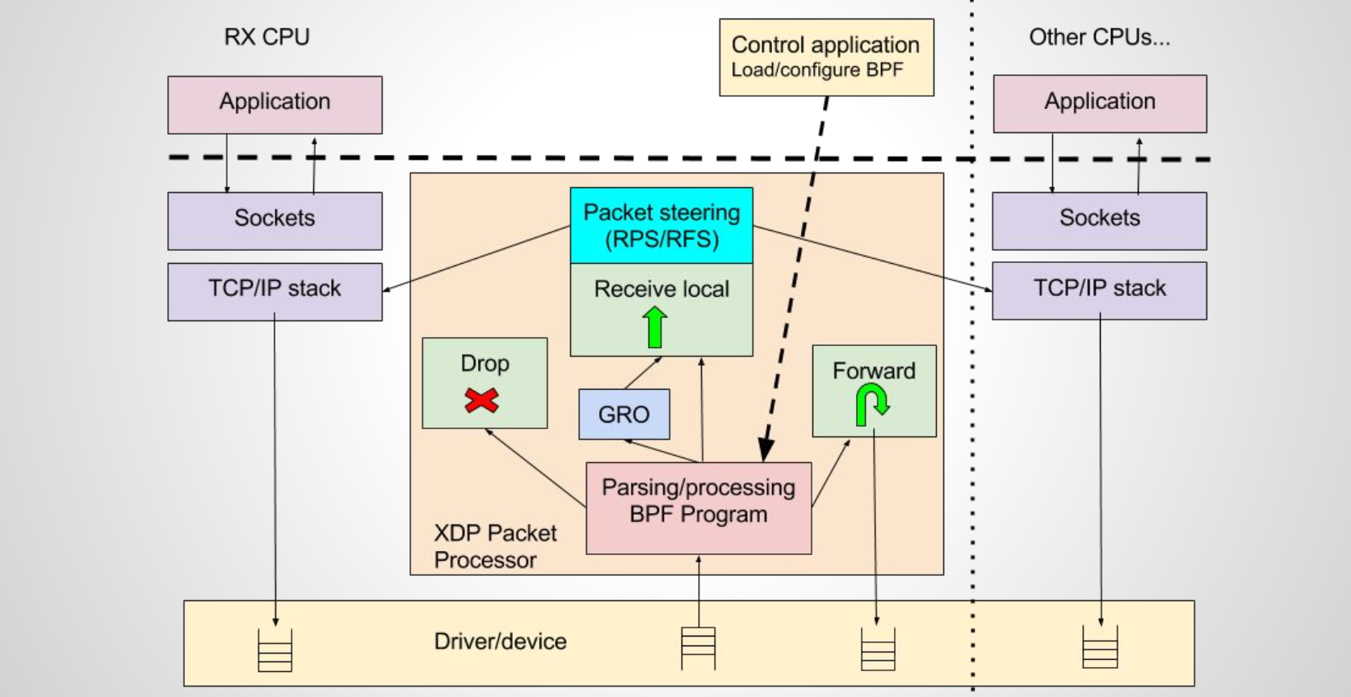
XDP Background
XDP – Programmable, High Performance Packet Processor in kernel data path

Slide 4
Proposed Solution
AF_XDP socket
Use XDP program to trigger Rx path for selected queue
DMA transfers use user space memory (Zero Copy)
HW descriptors mapped to kernel
Requires HW steering support
Copy-mode for non-modified drivers
Goal to hit 40 Gbit/s for large packets and 25 Gbit/s for 64 byte packets (37 Mpps) on a single core
New App
Legacy App
User Space
Libc
AF_XDP
socket
AF_INET
socket
Stack
Kernel
SKB
XDP
Linux NIC Driver
Cores + NICs
Modified Code
Un-modified Code

Slide 5
Packet Path Rx (ZC)
Interrupt Handler
softirq
EBPF
XDP_REDIRECT
ZC_RCV
NIC
Mmap’ed
“Loan” Ring
Mmap’ed
Rx Ring
Application
DMA

Slide 6
Operation Modes
From slower -> faster
XDP_SKB:
Works on any netdevice using sockets and generic XDP path
XDP_DRV:
Works on any device with XDP support (all three NDOs)
XDP_DRV + ZC:
Need buffer allocator support in driver + a new NDO for TX

Slide 7
NIC Driver Support (XDP_DRV + ZC)
ndo_bpf()
Enable/Disable ZC commands { .., XSK_REGISTER_XSK, XSK_UNREGISTER_XSK }
ndo_xdp_xsk_xmit()
Submit XDP packet when ZC is enabled
ndo_xdp_xsk_flush()
Update NIC Tx queue tail pointer

Slide 8
Security and Isolation for XDP_DRV + ZC
Important properties:
User space cannot crash kernel or other processes
User space cannot read or write any kernel data
User-space cannot read or write any packets from other processes unless packet buffer is explicitly shared
Requirement for untrusted applications:
HW packet steering, when there are packets with multiple destinations arriving on the same interface
If not available => XDP_SKB or XDP_DRV mode need to be used

Slide 9
DPDK Benefits
DPDK AF_XDP PMD
No change to DPDK apps
Linux handles hardware
Goal: < 10% performance decrease
No need for SR-IOV bifurcated drivers
DPDK App1
DPDK App2
DPDK App3
Linux NIC Driver
Cores + NICs
Goal: Linux should be used for HW setup, DPDK used purely as a shared library

Slide 10
Usage*
sfd = socket(PF_XDP, SOCK_RAW, 0);
buffs = calloc(num_buffs, FRAME_SIZE);
.. Pin memory with umem character device ...
setsockopt(sfd, SOL_XDP, XDP_RX_RING, &req, sizeof(req));
setsockopt(sfd, SOL_XDP, XDP_TX_RING, &req, sizeof(req));
mmap(..., sfd); /* map kernel Tx/Rx rings */
.. Post Rcv buffers ..
struct sockaddr_xdp addr = { PF_XDP, ifindex, queue_id };
bind(sfd, addr, sizeof(addr));
for (;;) {
read_messages(sfd, msgs, ....);
process_messages(msgs);
send_messages(sfd, msgs, ....);
};
*WIP

Slide 11
Experimental Setup
RFC V1 of AF_XDP published on January 31, 2018
Broadwell E5-2699 v4 @ 2.10GHz
2 cores used for benchmarks
Rx is a softirq (thread)
Tx is driven from application via syscall
TX and RX is currently in same NAPI context
Item in backlog to make this a thread on third core
One VSI / queue pair used on I40E. 40Gbit/s interface
Ixia load generator blasting at full 40 Gbit/s
TX
RX
App
Core 1
Core 2

Slide 12
Performance I40E 64-Byte Packets
“Results have been estimated based on internal Intel analysis and are provided for informational purposes only. Any difference in system hardware or software design or configuration may affect actual performance. Software and workloads used in performance tests may have been optimized for performance only on Intel microprocessors. Performance tests, such as SYSmark and MobileMark, are measured using specific computer systems, components, software, operations and functions. Any change to any of those factors may cause the results to vary. You should consult other information and performance tests to assist you in fully evaluating your contemplated purchases, including the performance of that product when combined with other products. For more information go to http://www.intel.com/performance/datacenter.
 | AF_PACKET V3 | XDP_SKB | XDP_DRV | XDP_DRV + ZC
rxdrop | 0.73 Mpps | 3.3 Mpps | 11.6 Mpps | 16.9 Mpps
txpush | 0.98 Mpps | 2.2 Mpps | - | 21.8 Mpps
l2fwd | 0.71 Mpps | 1.7 Mpps | - | 10.3 Mpps
XDP_SKB mode up to 5x faster than previous best on Linux
XDP_DRV ~16x faster
XDP_DRV + ZC up to ~22x faster
Not optimized at all at this point!
Rxdrop for AF_PACKET V4 in zero-copy mode was at 33.7 Mpps after some optimizations. We have more work to do.

Slide 13
Future Work
More performance optimization work
Try it out on real workloads
Make send syscall optional and get TX off RX core
Packet steering using XDP
Metadata support, using XDP meta_data
Queue pairs w/o HW support gets emulated
XDP redirect to other netdevices RX path
1 XDP program per queue pair
XDP support on TX
Multi producer single consumer queues for AF_XDP
Clone pkt configuration

Slide 14
Conclusions
Introduced AF_XDP
Integrated with XDP
AF_XDP with zero-copy provides up to 20x performance improvements compared to AF_PACKET V2 and V3 in our experiments on I40E NIC
RFC on the netdev mailing list
Still lots of performance optimization and design work to be performed
Lots of exciting XDP extensions possibile in conjunction with AF_XDP
Check out the RFC:
https://patchwork.ozlabs.org/cover/867937/

Slide 15
Acknowledgements
Alexei Starovoitov, Alexander Duyck, John Fastabend, Willem de Bruijn, and Jepser Dangaard Brouer for all your feedback on the early RFCs
Rami Rosen, Jeff Shaw, Ferruh Yigit, and Qi Zhang for your help with the code, performance results and the paper
The developers of RDMA, DPDK, Netmap and PF_RING for the data path inspiration
Check out the RFC:
https://patchwork.ozlabs.org/cover/867937/

Slide 16
Questions?

